Slide 1
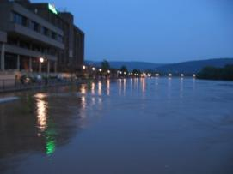
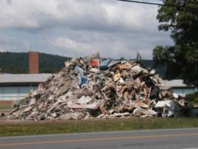
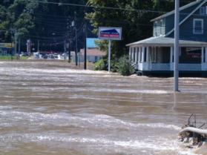
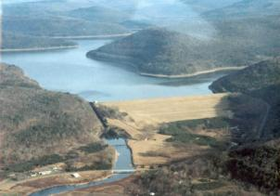
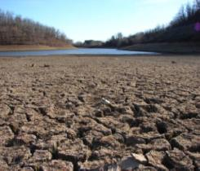
Decision Support Services
From Flooding to Drought
Barbara Watson
Meteorologist-in-Charge
National Weather Service
Binghamton Forecast Office

Slide 2
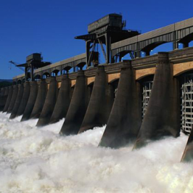
NWS New Strategic Plan 2020
Focuses on providing customers and partners with Impact Based Decision Support Services
Works with Social Scientists to better understand how weather and flooding impact society and how people respond to weather threats and warning messages
Works closer with collaborating agencies and partners to more effectively achieve goals
More emphasis on climate and climate and environmental impacts

Slide 3
Water Forecasting Challenges
Forecast Uncertainty
Years
Seasons
Months
Forecast Lead Time
Weeks
Days
Hours
Minutes
Benefits
Protection of Life & Property
Hydropower
Recreation
Ecosystem
State/Local Planning
Environment
Flood Mitigation & Navigation
Agriculture
Reservoir Control
Health
Commerce
Notes:
Water and weather forecast information is needed to serve diverse groups of customers that require decision support services for a range of time frames from minutes and hours for flash flooding, days for river stages, to long range outlooks for temperatures and rainfall trends.

Slide 4
Degrees of Decision Support
Increasingly direct interaction
between NWS and
decision makers
Increasing adaptation
of NWS information for
specific decision(s)
Individual Decision
Assistance
Group
Decision Assistance
Organization-Specific
Decision Support Information
Sector-Specific
Decision Support Information
General Access to NWS Information
All NWS Customers / Partners
Notes:
The National Weather Service envisions a multi-tiered approach to delivery decision support services to our customers. The bottom tier of the pyramid is our forecast, warning and informational services that are available to the public. As you move up the pyramid, direct interaction with decision makers increases. We will take a look at each level of service and pay particular attention to the top area of hands-on services.

Slide 5
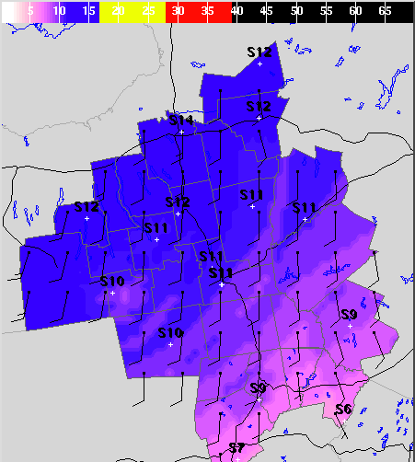
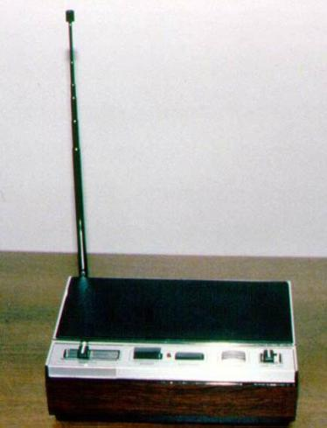
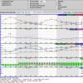
General NWS Information
Updated every 3 hours and available via web and NOAA weather radio
Notes:
The bottom tier of decision support services pyramid is the foundation of the National Weather Service.
Forecasters work around the clock 24/7 developing a digital forecast database of temperature, winds, clouds, probability of precipitation, rainfall, snowfall, ice amounts, probability of thunder, and much more for each hour out to seven days for every 5 km grid point in our forecast area. Computer models and “Smart Tools” help us to accomplish this. The first 24 hours of the forecast is updated seven times a day, with significant weather out to day 3 updated 4 times a day and weather out to day 7 updated 1 to 2 times per day. Watches, warnings, and statements are issued whenever forecasters reach a confidence level that a trigger point will be reached.
These forecasts are delivered to you via web and radio. You can read them as text products or see them visually as graphs and images.

Slide 6
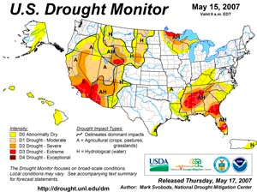
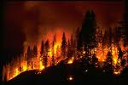
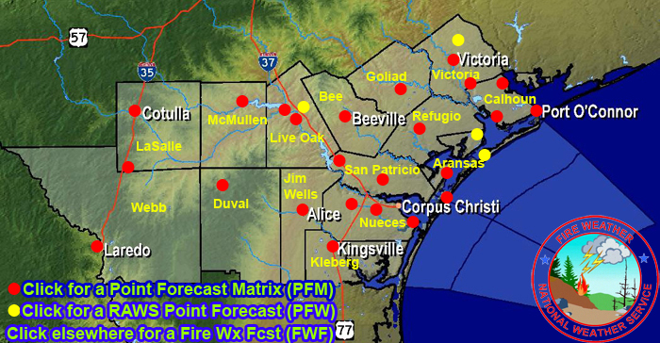
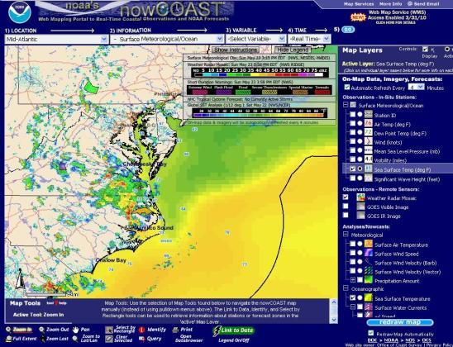
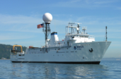
Sector Specific Decision Support
Aviation
Marine
Fire Management
Water Management
Notes:
The National Weather Service supplies tailored forecasts to certain key sectors for public safety. These forecasts draw data from the same digital forecast database, but data is focused on, and formatted for, the needs of that sector. For example, aviation customers are concerned with cloud bases and visibilities; marine customers want winds and waves; fire weather customers are concerned about winds and relative humidity; and water customers are concerned about rainfall and frequency. That is a simplification, but it demonstrates the diversity.

Slide 7
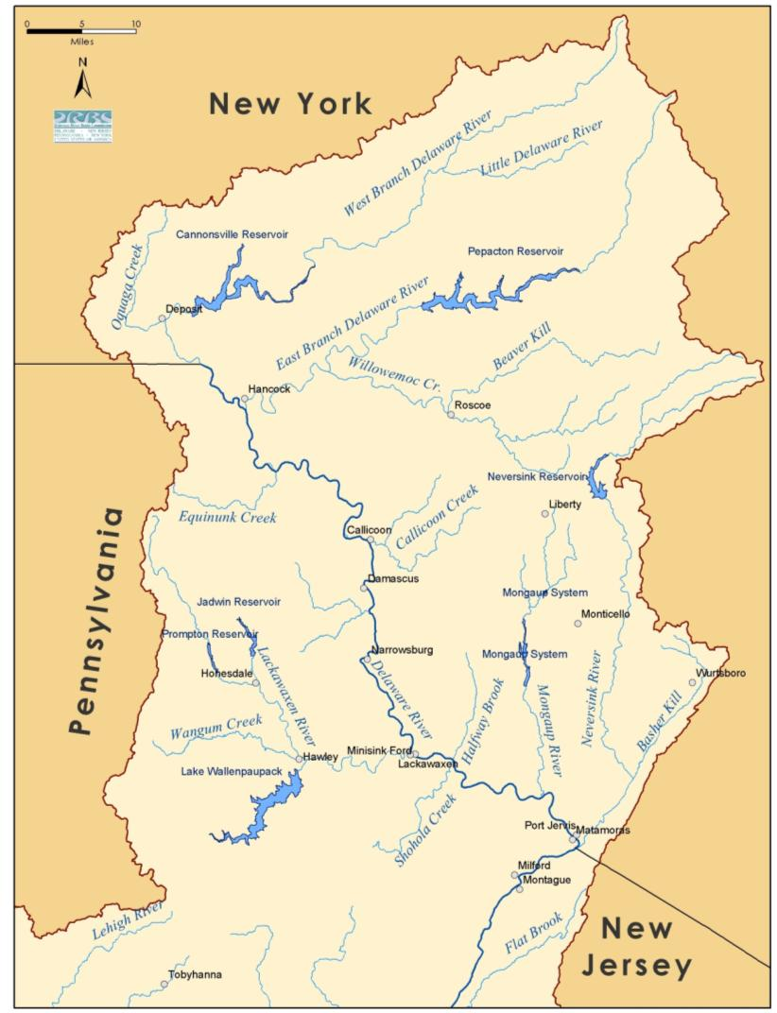
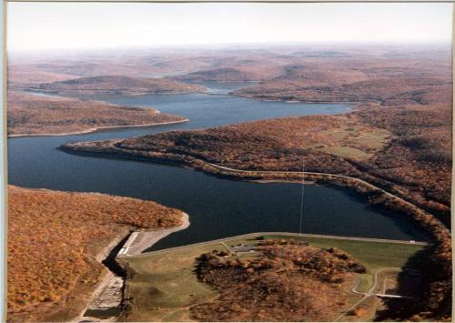
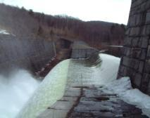
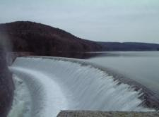
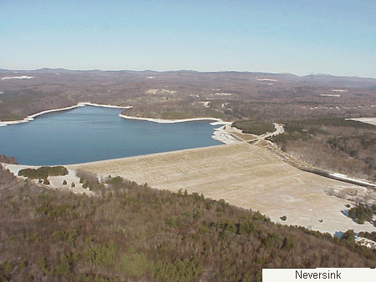
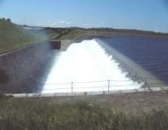
New York City Reservoirs
Organization Specific Decision Support Services
Photos Courtesy NYC DEP
Notes:
This is an example of Organization Specific Decision Support Services for managing the reservoirs and water flow levels on the Delaware River. These reservoirs retain drinking water for New York City, but also release water to maintain healthy water flow in the Delaware River as regulated by the Delaware River Master. The National Weather Service help by providing rainfall forecast outlooks and helps with modeling the river flow.

Slide 8
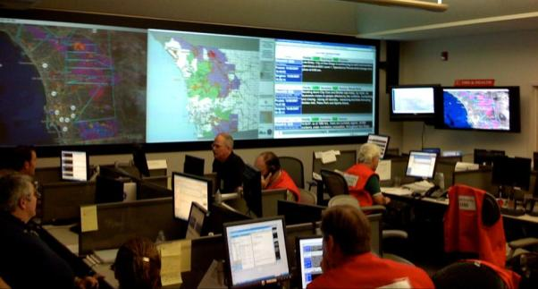
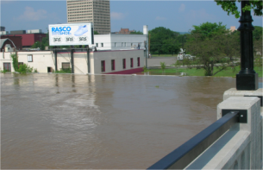
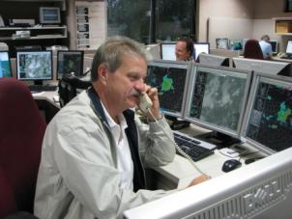
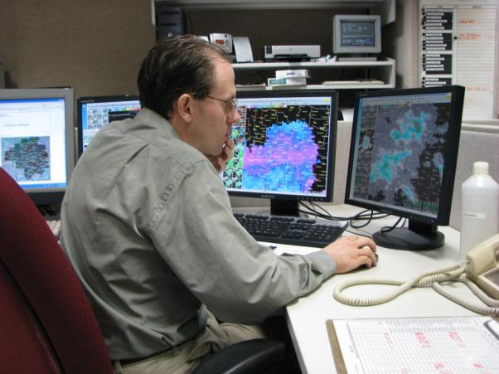
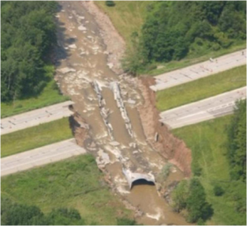
Group Decision Support
Prior to Significant Weather Events:
Webinars
Conference Calls
To State and County EOCs and other key partners
To help prepare, respond and mitigate against potential harm to public and property
Notes:
The National Weather Service provides decision support services to large groups across multiple states in the form of briefings and webinars. These are commonly given to State and County EOCs prior to, during and sometimes after significant weather events such as floods to help with planning, mitigation and response. Up to 50 different agencies may be participating within the State EOC and likewise, county EOCs can include various departments and agencies involved in response and recovery.

Slide 9
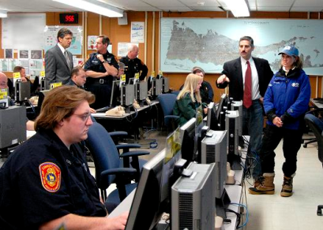
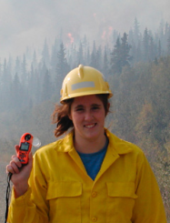
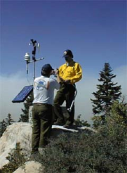
Individual Decision Support for Significant Weather Incidents
Briefings to county from the weather office
Rapid changing/critical decisions can go to on-site support with a meteorologist in the EOC or at the Incident Command Post
Can arrive with our own equipment and communications
County Emergency Operations Center
Incident Meteorologist (IMET) can provide on-site briefings
Hurricane impacts and aftermath, Significant Floods, Significant Ice Storm, localized high impact incident
Notes:
The most common form of individual decision support occurs with just a phone call. If a significant weather event is approaching a county, the National Weather Service office may call the county warning point or emergency manager to give them a heads up. An emergency manager may call the National Weather Service to get additional information and specifics for critical decisions such as evacuations or deployment of resources and other actions.
Working from the weather office, forecasters can brief customers via phone or through webinar using the latest data available. However, sometimes, conditions are changing rapidly and decisions need to be made quickly such that real-time face-to-face communication is necessary. In this case, a meteorologist can be deployed to the EOC or incident command post. The next couple slides will show non-weather events that can trigger this need when there is a continuing risk for weather to cause.

Slide 10
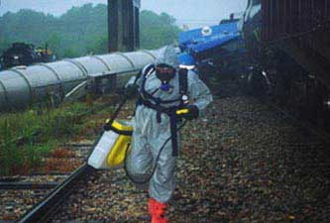
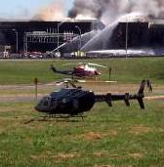
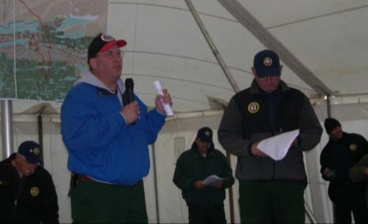
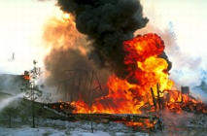
Individual Decision Support for Non-Weather Incidents
State Emergency Operations Center
Incident Meteorologist (IMET) can provide on-site briefings
HAZMAT incidents, oil spill, train wreck, airplane crash, potential dam break, terrorist incident, nuclear power plant
Notes:
NOAA and the National Weather Service have resources for providing all sorts of services to assist with determining how spills will flow in water, how gases (chemical, smoke, nuclear) will disperse in the atmosphere, HAZMAT support, weather support for search and rescue operations or aviation weather support associated with response to an incident.
Briefings can be provided via phone, via webinars, or on-site with a certified incident meteorologist (IMET). When a significant event happens and a prolonged response is required such as the events on 911 or the recent oil rig disaster in the Gulf of Mexico, NWS can work to meet special support requirements including specialized forecasts, web pages, GIS overlay products, and other decision aids.

Slide 11
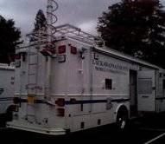
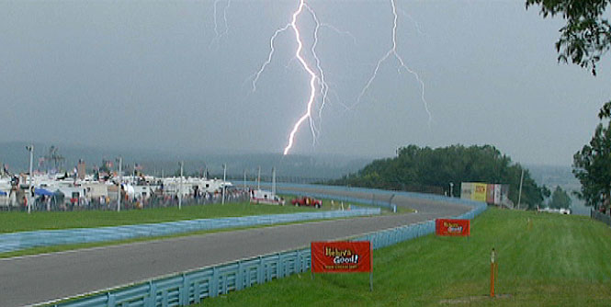
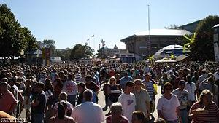
Individual Decision Support to Incident Command for Large Public Events
IMET on-site
- - or - -
Briefings to incident command from Local NWS office with preset criteria to ensure public safety
Incident Command Center
Watkins Glen NASCAR 2009 – just 1 min before race time
Binghamton Spiedie Fest and Balloon Rally – Winds over 12 mph become unsafe for public and balloon operations
New York State Fair – 3 people killed in 1998 from a line of severe thunderstorms with extreme winds
Notes:
Large public outdoor gatherings place people at risk to hazardous weather. The National Weather Service can work with County and local officials to plan what actions will need to occur to get people to shelter in various scenarios and then provide warnings within a certain timeline to ensure the public’s safety. In some cases, the National Weather Service has staffed a booth at the event and provided on-scene support.
The pictures in this slide show three examples from New York State. The Watkins Glen International NASCAR race is the largest outdoor event in the state. Lightning poses the most common threat to outdoor events, though two years prior to this a tornadic thunderstorm moved close to the event. High winds are another common threat. At an air show in Huntsville, a microburst (burst of wind that impacts a small area) hit and air show collapsing and blowing over large tent. A piece of flying debris killed a bystander. At the New York State Fair on Labor Day in 1998, a line of severe thunderstorms with winds over 70 mph struck the fair grounds after midnight. Many people, vendors, exhibitors, and attendees were camping at the event and 3 people were killed. Large hail, flash floods, lightning, tornadoes have all hit large public events in the past and caused tragedy. Having a good safety plan and warning communication can, in most cases, prevent or minimize the disaster.

Slide 12
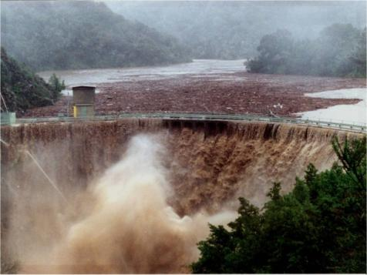
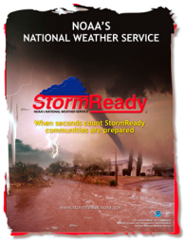
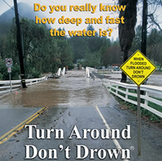
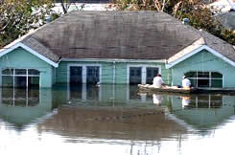
Individual Decision Support to help with Preparedness and Mitigation
Hazard Mitigation
Risk Assessment
Safety & Preparedness Education
StormReady
Specialized Training
Exercises
Drills
Notes:
As emergency managers know, planning for response and mitigation begins long before an event. The National Weather Service can help provide its expertise to help with assessment, planning, and education. We can help with training, drills and exercises. We can work together to recruit volunteer weather spotters and work to recognize counties, communities, universities, and large businesses as “StormReady.”

Slide 13
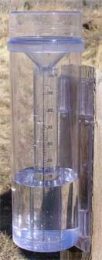
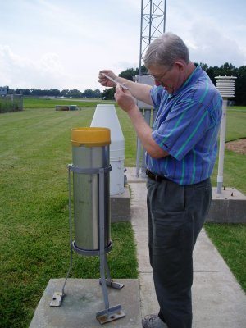
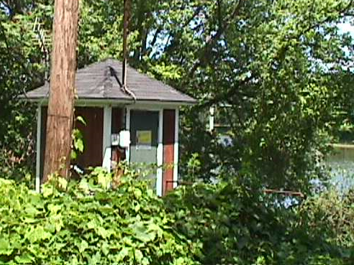
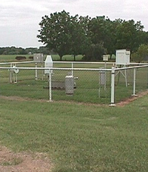
Individual Decision Support to Monitor and Observe Environmental Data
Sighting of automated weather stations and gages
Quality control and assimilation of data
Training Observers
Cooperative Observer Station
Measuring rainfall
Conklin, NY River Gage house
Notes:
With your help, we can help set up volunteer observer networks in your county or community to help detect, warn and document hazardous weather. CoCoRaHs is a national community based program of volunteer rain, snow and hail spotters. Skywarn is a national program of trained severe storm spotters with some being amateur radio operators who have a history of providing the National Weather Service with critical information from isolated communities during floods, hurricanes, and ice storms. They also provide communication from the National Weather Service back to the local communities. Cooperative Observer Program is a national network of people who take reports of temperature and precipitation 365 days a year forming a climate record for communities and the nation and help support the daily forecast process as well. The National Weather Service does not own river gauges, but does support many gauges with determination of flood stage and with warning and forecast services. We can work with communities to determine locations, actions, and services. Staff gauges (often lines painted on a bridge showing the depth of the water) along with volunteers to read them can also help support forecast and warning services for a community. The National Weather Service can work with a community to develop this.

Slide 14
Questions?

